Slide 1
MyDepot Business
Tiger Case study
Confidential
DD-MMM-YYYY
John Smith

Slide 2

Team Intro
AJAY SOLANKI
DATA SCIENCE ANALYST

Slide 3
Topics/Agenda
01
｜
OBJECTIVE
02
｜
DATA DISCOVERY
03
｜
DATA EXPLORATION AND FEATURE ENGINEERING
04
｜
MODELLING AND BUSINESS OPPORTUNITY

Slide 4
OBJECTIVE
Our client (MyDepot) is a leading retail chain business.
Client wants to reduce marketing spend afer deep impact of covid-19.
By Analyzing past campaign data generate insights for better-optimiized and personalized marketing campaign.

Slide 5
Data Discovery
Preferred Category
Consumer Frequency and Recency
Data quality and sparsity

Slide 6
Data Sets
Data Set | Description
Campaign_data | Previous campaign’s data including columns (e.g treatment, conversion, customer_class, etc.)
Customer_table | Master data of all customers containing customer id, name, city and Phone number
Order_table | Cotains all orders details such as order product category, status, and order placed, and delivered date
Transaction_table | Include all order’s transaction details (e.g. grand_total, payment mode)

Slide 7
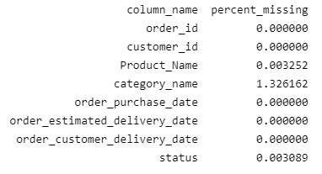
Missing Values
After Checking each table for missing values:
Customer table doesn’t have any missing value
Transaction_table have only two missing values in discount_amount
Order_table have null values
From the table of missing values percentage we can se that category_name contains 1.3% null values
Product_Name and status column also have some null values

Slide 8
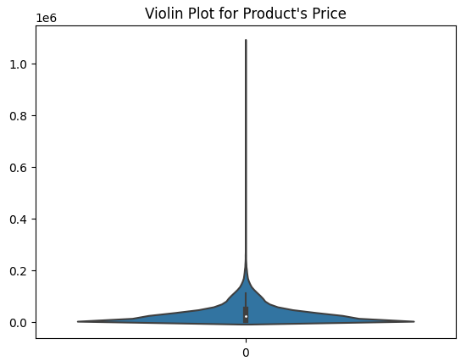
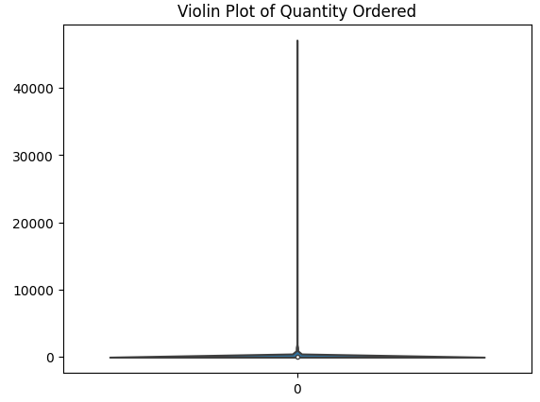
2. Anomaly detection in Order_table
Order Table
Order table seems to have outliers data in price and quantity order column
But after carefully overserving those values seems legit, (for example product price is too big for top 0.00001 percentile customers and product category is Appliance and Entertainment)
Same for qty_ordered column, order placed in bulk have product price around from 1.0 -4.0 price range

Slide 9
Data Exploration and Discovery
Top revenue generating Category
Revenue and order sales Share of each category, payment mode
What are Customer’s recency, frequency of order placing
Conversion rate of treatment and Control Group

Slide 10
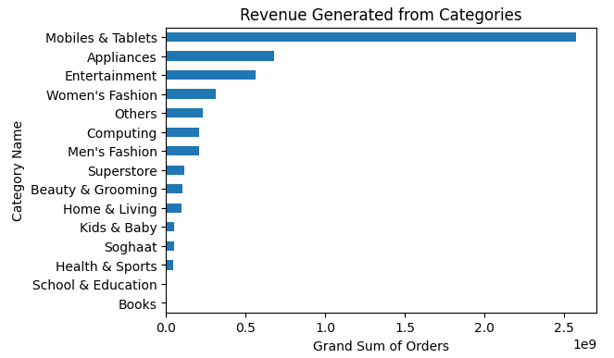
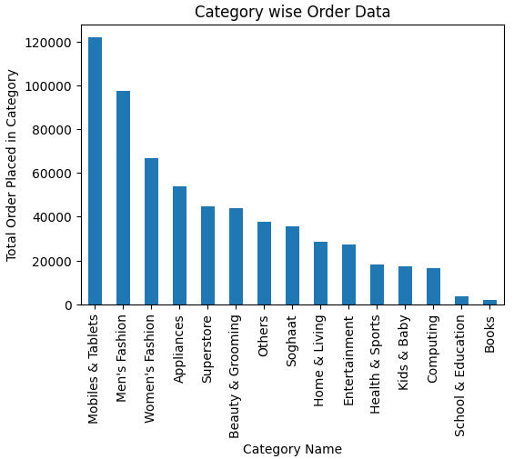
Sales & Revenue of products in Different categories
Top category is ‘Mobiles & Tablets’ from total order placed and Revenue generated
Revenue generated is around 50% from top category
On Second Position, Order placed in Men’s Fashion but revenue generated from Appliances category

Slide 11
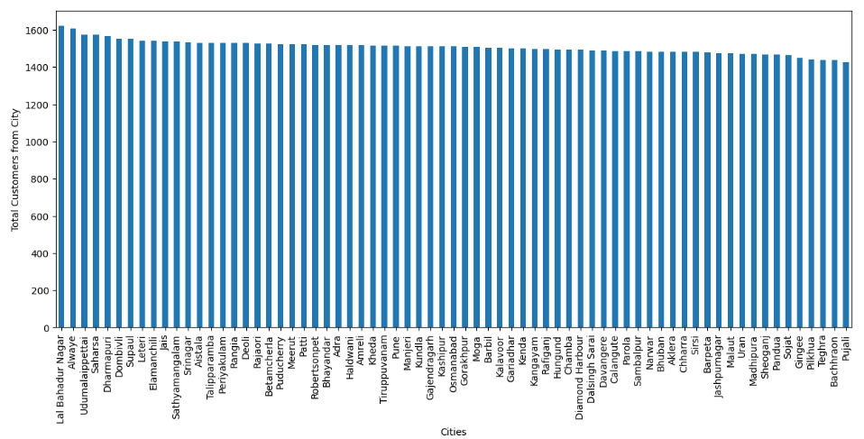
Understanding the overall business share of cities
On average, each city has a similar proportion of business in terms of orders placed.

Slide 12
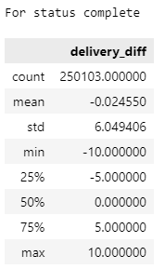
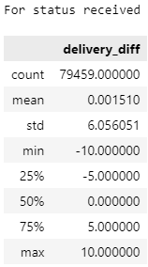
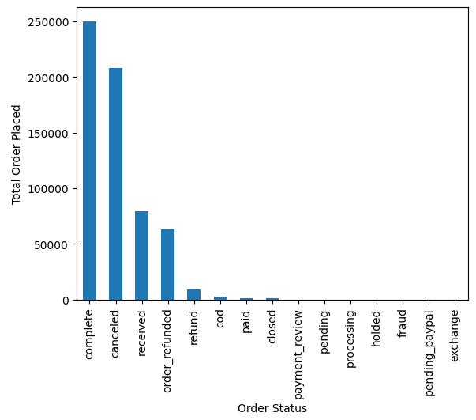
Revenue Propotion of Each Status Type
Relation Between Complete & Received Status
Calculated delivery date difference (estimated & actual delivery date)
There is no clear relation between order delivery date and order estimated delivery date for order status.
both type of order status have estimated and actual delivery date difference ranging from -10 to +10 days
This means for both type of status orders are arriving early and also late from the expected delivery date
Order status canceled is almost same propotion as ‘complete’ status, revenue generated is less

Slide 13
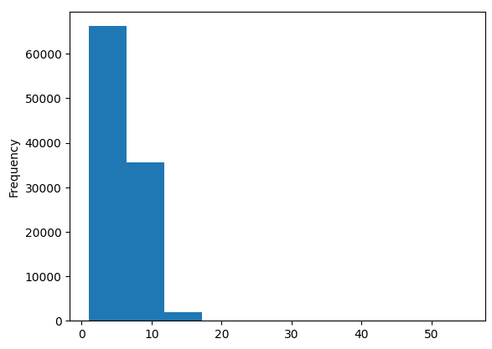
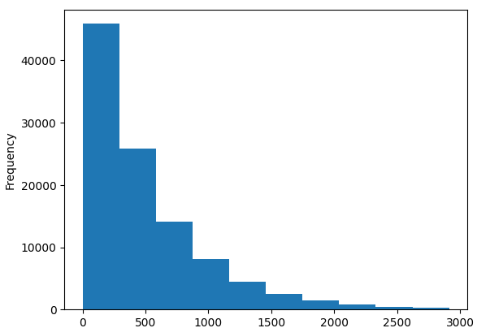
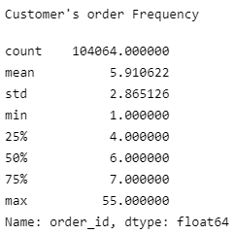
Order Frequency & Order Recency
From the plot and described dataframe, it is clear that customers usually placed 4-7 orders.
Till 75% percentiles people placed less number of order in comparison to the customers who placed orders upto 55.
Customers on average placing 6 orders.
Recency distribution is right tailed, it means most of the last order placed by customers are in recent time.
With increasing time (recency decreasing), number of customer is also decreasing. So there are few number of customers who haven't placed any order in a very long time.

Slide 14
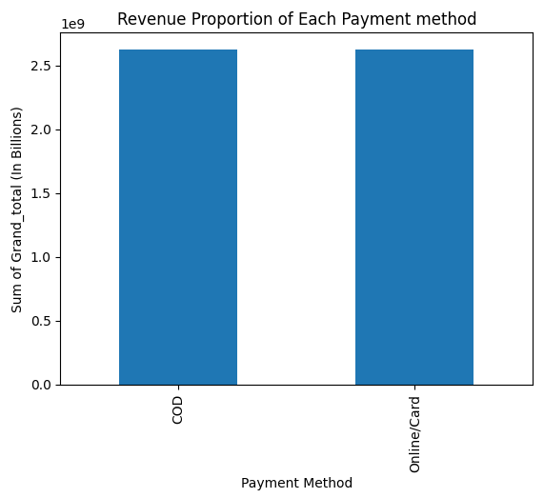
Transaction_table
On average, Each payment method have equal proportions of total revenue generated

Slide 15
Queries
What is the grand_total for each status type?
For Each category what is the Total Order placed and Revenue generated via different Payment methods
What are the total order status for each payment mode?

Slide 16
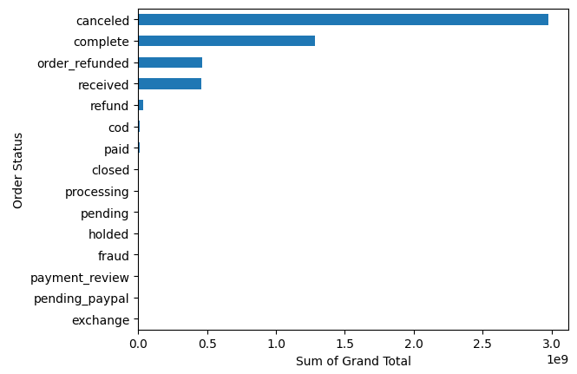
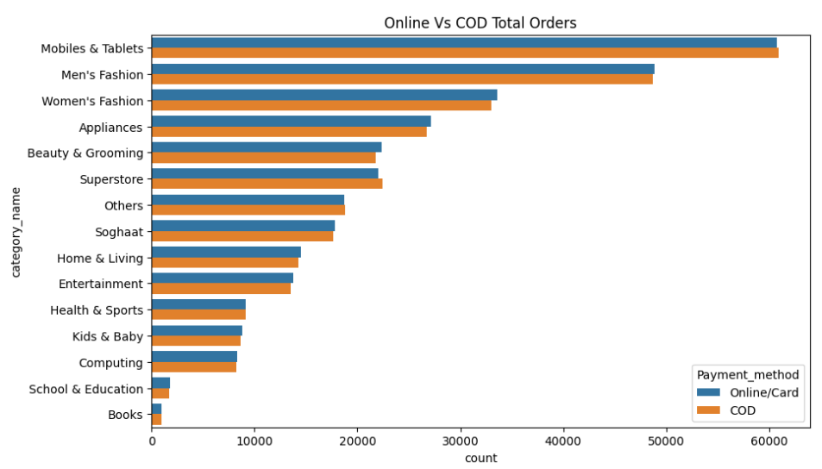
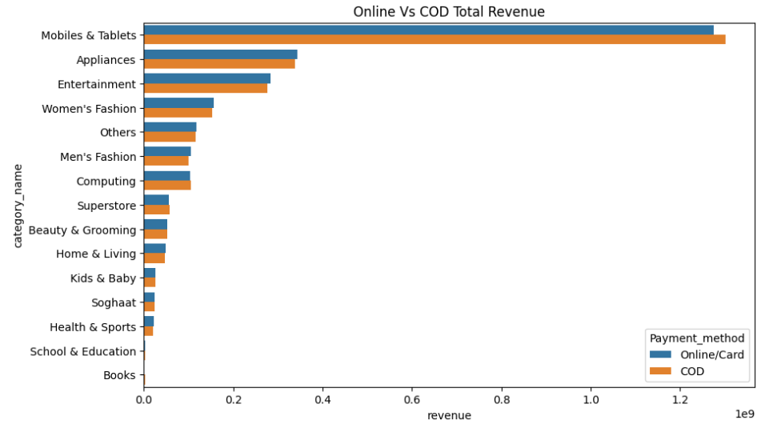
Conclusions:
More than half (~57% Sum of all orders grand_total is of canceled status
Only 25% of order status is complete with 9% of received status
For Each payment method, in every category total order placed and revenue collected is almost same

Slide 17
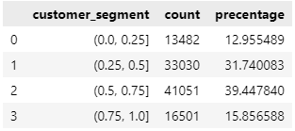
RFM Analysis
Customer Segmentation based on RFM score
Above 0.75 RFM score, include around 16% of customer population.
From a marketing spend perspective if business focus on this segment, it would generate more revenue and get positive response

Slide 18
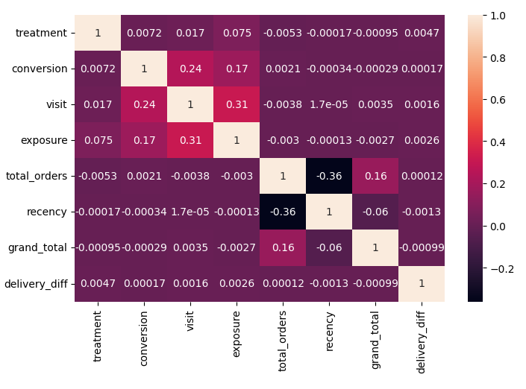
Correlation
Correlation Heat map showing that Recency and total_orders have high negative score (-0.36), Recency is negatively correlated, which is right. Because if recency increase then total orders decrease
Visit and exposure showing high correlation
High correlation between parameters can be problematic in some cases, as it can make it difficult to determine the individual contributions of each parameter to the overall model performance.

Slide 19
Modelling and Business Opportunity
Estimating Conversion Rate
Calculating Different Metric for Models
Calculating Lift Score

Slide 20
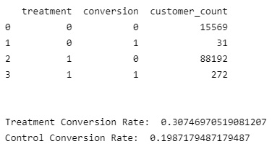
Treatment & Control Group

Slide 21
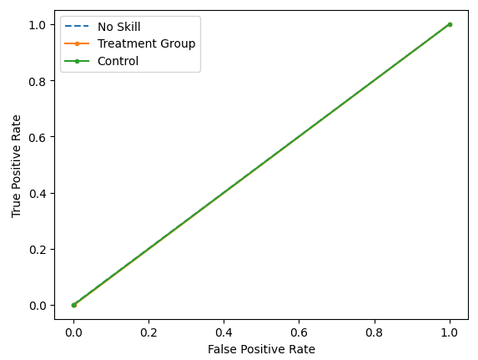
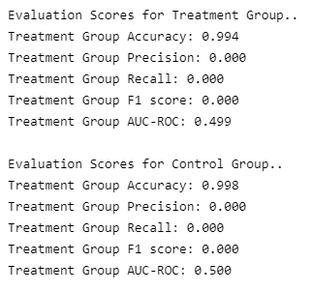
Random Forest Classfier

Slide 22
Thank You
Do you have any questions?

Slide 23
Next Steps
Feature Engineering
Another Model approach
Evaluation Metrics

